Slide 1


Slide 2
Agenda
Introduction and training of Z21 – Discovery phase
Generate New ideas – Huddle in group of 4 to 6 members
Pitch new idea - Create PRFAQ, Elevator pitch and product in a box for the chose idea
Assign ownership - in JIRA

Slide 3
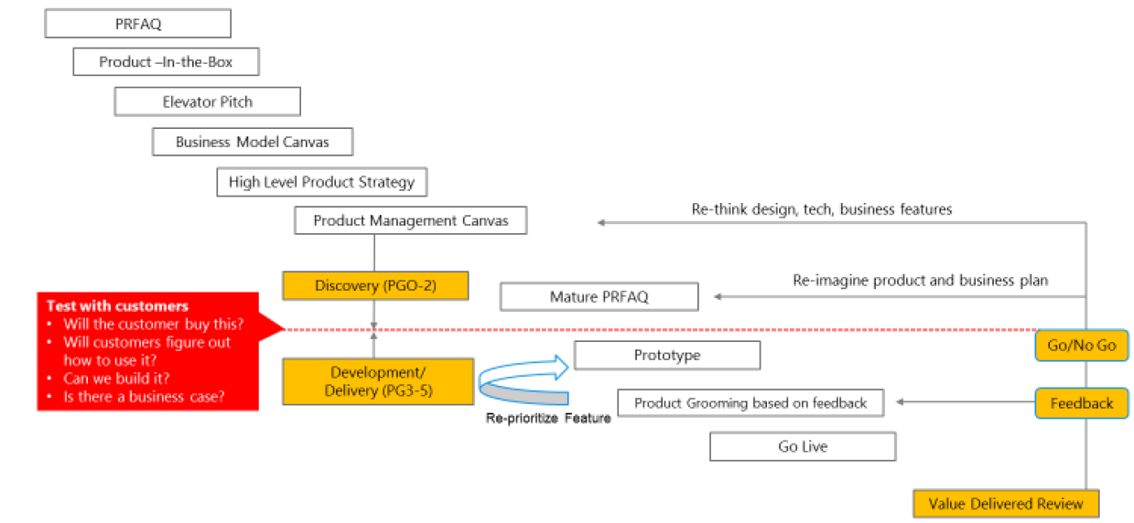
Zero-to-one (z21) npi process

Slide 4
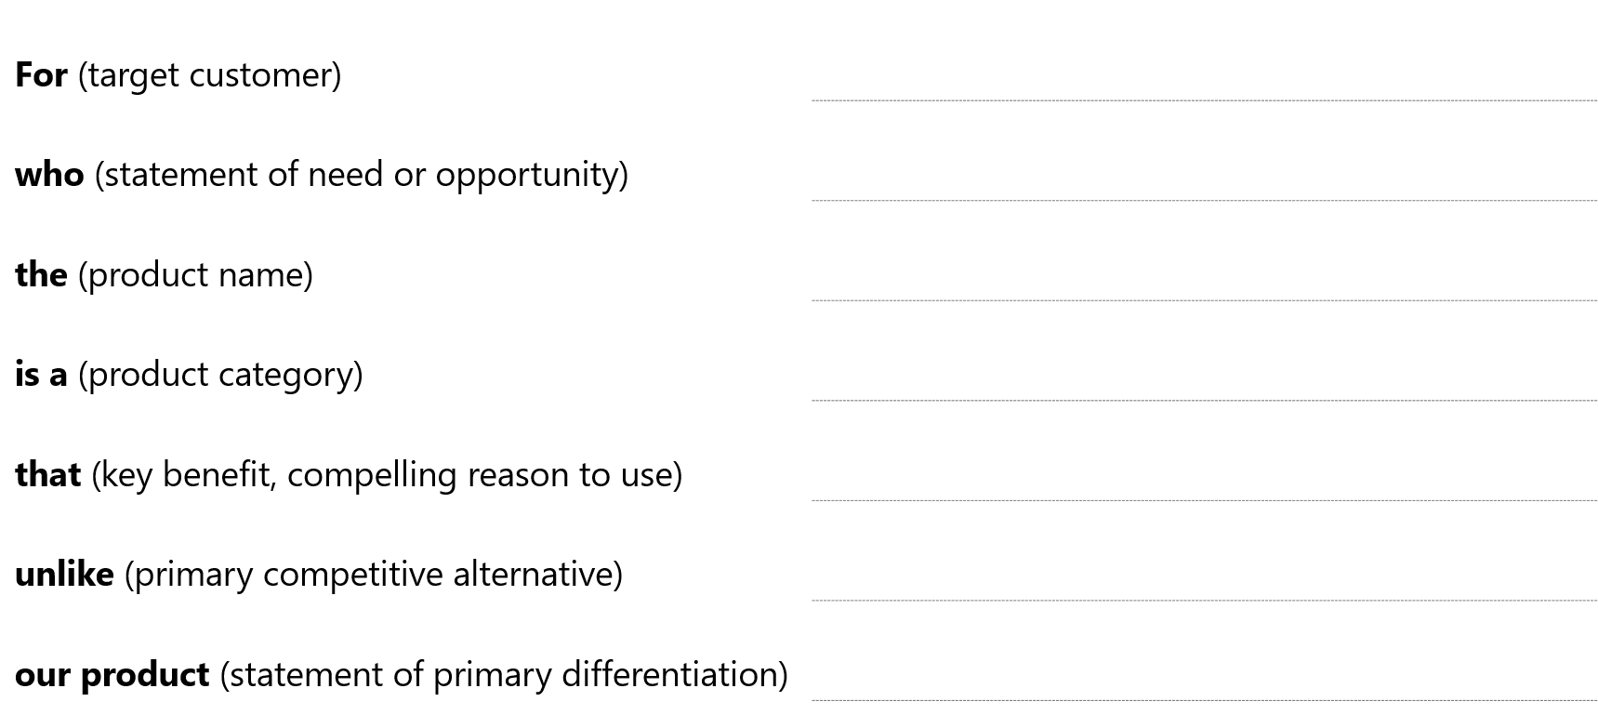
Elevator pitch

Slide 5
PR & FAQ
PR (Press Release) Outline:
Heading —Name the product in a way the reader (i.e. your target customers) will understand.
Sub-Heading —Describe who the market for the product is and what benefit they get. One sentence only underneath the title.
Summary —Give a summary of the product and the benefit. Assume the reader will not read anything else so make this paragraph good.
Problem —Describe the problem your product solves.
Solution —Describe how your product elegantly solves the problem.
Quote from You —A quote from a spokesperson in your company.
How to Get Started —Describe how easy it is to get started.
Customer Quote —Provide a quote from a hypothetical customer that describes how they experienced the benefit.
Closing and Call to Action —Wrap it up and give pointers where the reader should go next.
FAQ (Frequently Asked Questions):
Guidelines:
Keep it simple.
3-4 sentences for most paragraphs.
Don’t make it into a spec.
Accompany the press release with a FAQ.
No Geek-Speak

Slide 6

Product-in-a-box
Logo
Product Roadmap (MVOs)
MVO 1
MVO 2
MVO 3
Product Name
Company, price, regulatory information for users
Content of box
Directions to use this product
Visual
Representation
Business Case summary
- Revenue over next 3 years
- Costs
Product Promise

Slide 7
Product Stack (Product Strategy)
Apps / Websites / Dashboards | Integration with 3P Apps / Hardware | Integration with 3P Platforms
3P SDK | SDK
API Layer
Platform (Single Pane of Glass)
API Layer
Dashboards, Admin, Utilities, Portals etc | Integration of 3P Apps / Hardware | 3P Platforms e.g. SFDC
User facing
Inside facing

Slide 8
Product Management Canvas
Product Name:
1. Idea Problem/Opportunity: what unique need is being addressed? | 2. Market (PxQ) Market size: TAM and SAM Key partners: Key competitors: | 4. Business Value Product-Market Fit Product-Org Fit Revenue model Cost analysis Regulatory and compliance | 5. Features Value prop / unique selling propositions Key features | 6. KPIs Success criteria Viability criteria Failure criteria
 | 3. Cust. Segment Early adopters B2B, personas
7. Evangelism {“selling the dream”} Elevator pitch Content strategy Terminology SEO strategy Brand assets (e.g. domains) Support channels Sales training | 8. Visual Identity Name Logo, icons, brand playbook Presentation, docs template Product docs, template Digital assets, content | 9. Go to Market What to sell (for each customer segment)? Who to sell to? How to sell? Pricing? Sales channel? | 10. Key Resources Licenses 3P platforms, analytics tools, SDK, Sentience | 11. Risks Shortcomings Assumptions Disruption readiness

Slide 9
Business Model Canvas
Key Partners | Key Activities | Value Proposition |  | Reference Customers | Cust. Segments
 | Key Resources |  |  | Channels (CDJ) (awareness, consideration, engagement, purchase)
Cost Structure |  |  | Revenue Streams
1
2
3
4
5

